Slide 1
Session 6
Introduction to ASP.NET MVC
For Aptech Centre Use Only

Slide 2
Session Overview
Describe ASP.NET MVC
Explain ASP.NET MVC life cycle
Define ASP.NET MVC pattern
List the advantages of MVC-based Web applications
Explain the Models in ASP.NET
Explain how model binding and validation is performed
Describe Views in ASP.NET
Explain Controllers in ASP.NET
For Aptech Centre Use Only

Slide 3
Introduction to ASP.NET MVC
Three basic components of ASP.NET MVC:
Model (Business Entities) View (Presentation Logic)
Controller (Business Logic)
For Aptech Centre Use Only

Slide 4
Advantages of Separation of Concerns (SoC)
Allows work on individual pieces of the system in isolation
Facilitates reusability
Ensures the maintainability of a system Ensures extensibility
Enables users to better understand the system
For Aptech Centre Use Only

Slide 5
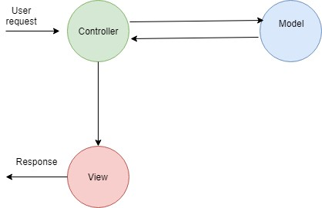
ASP.NET MVC Pattern
For Aptech Centre Use Only
ASP.NET MVC Pattern

Slide 6

ASP.NET MVC Lifecycle
1
Application
For Aptech Centre Use Only
Involves the time from which the application process starts to execute Internet Information Services (IIS) up to the time it ceases.
2
Lifecycle
Request Lifecycle
Involves the events that occur when an HTTP request is received by the application.
3
4

Slide 7
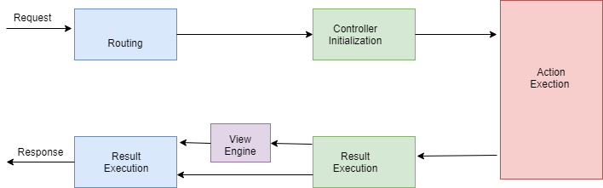
ASP.NET MVC Request Lifecycle
For Aptech Centre Use Only
Request Life Cycle

Slide 8
Advantages of ASP.NET MVC
Provides asynchronous technique
Changes do not impact the complete model
Easy to Test, called Test Driven Development (TDD)
SEO friendly development platform
For Aptech Centre Use Only

Slide 9
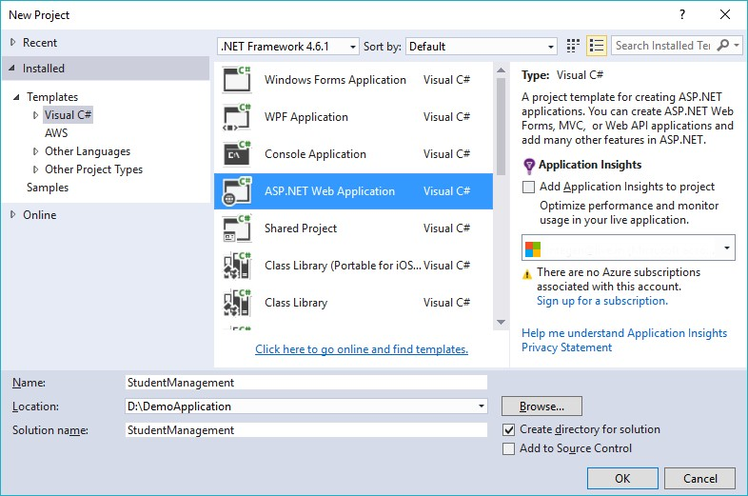
Creating a Simple MVC Application (1-2)
For Aptech Centre Use Only
New Project Window

Slide 10
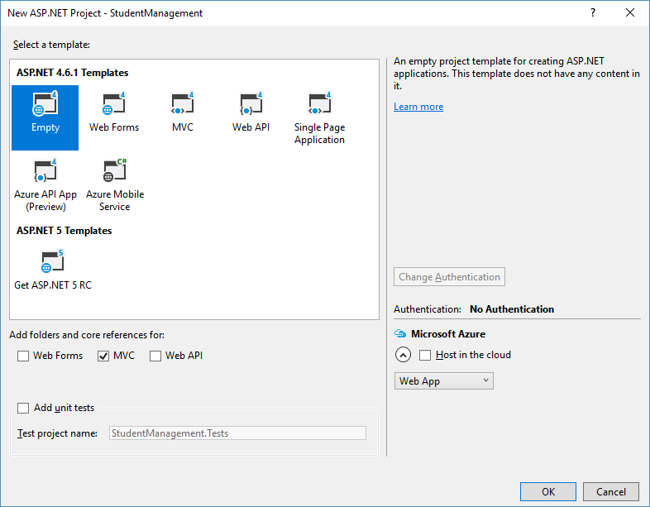
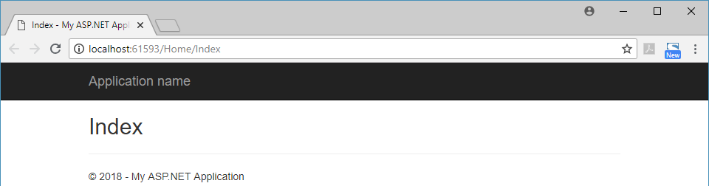
Creating a Simple MVC Application (2-2)
New ASP.NET Web Application Window
For Aptech Centre Use Only
Index() Method Output

Slide 11
Models in ASP.NET MVC
Models are Containers that are specific to the business
Don’t Repeat Yourself (DRY) Model Binding
Adding Validations to Model
For Aptech Centre Use Only

Slide 12
Controllers in ASP.NET MVC
Controllers help in managing complete flow of application including accepting input and rendering appropriate output.
Controllers are basically C# classes that inherit from System.Web.Mvc.Controller.
Controller along with its action method accepts incoming browser requests, retrieves required model information, and provides suitable responses.
It is recommended that class name of a controller ends with ‘Controller’.
For Aptech Centre Use Only

Slide 13
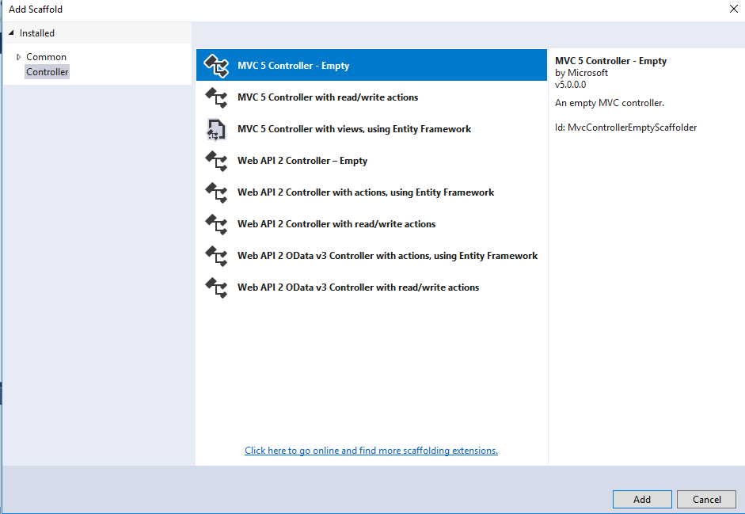
Creating Controller in an Application
Add Scaffold Dialog Box
For Aptech Centre Use Only
The pre-installed code generators for MVC and Web API projects provided by Visual Studio is called Scaffolding.

Slide 14
Routing and Custom Routes (1-2)
Routing defines how the application will process and respond to an incoming HTTP request.
When an ASP.NET MVC application is created using Visual Studio.NET, a route is automatically configured in the RouteConfig.cs file under App_start folder.
The RouteConfig class contains a MapRoute() method.
For Aptech Centre Use Only

Slide 15
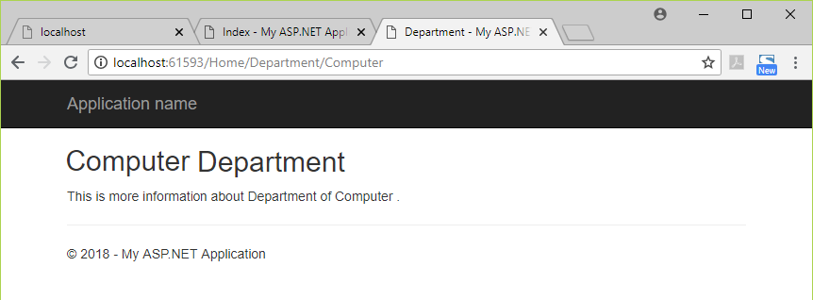
Routing and Custom Routes (2-2)
For Aptech Centre Use Only
Department Output

Slide 16
Views in ASP.NET (1-2)
An ASP.NET MVC application includes a view, which is similar to a page.
A controller action performs one of the two tasks at a time, displaying a view or forwarding it to another controller action.
It is possible to create additional views in an application.
For Aptech Centre Use Only

Slide 17
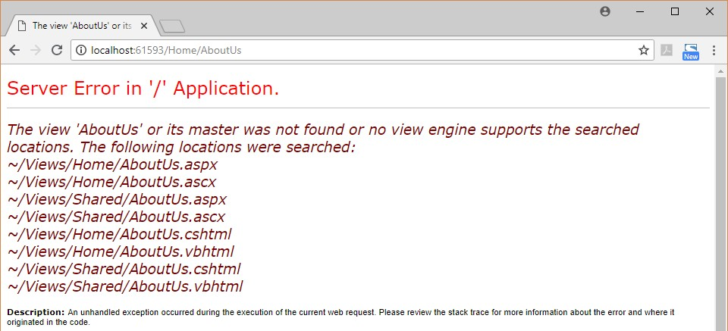
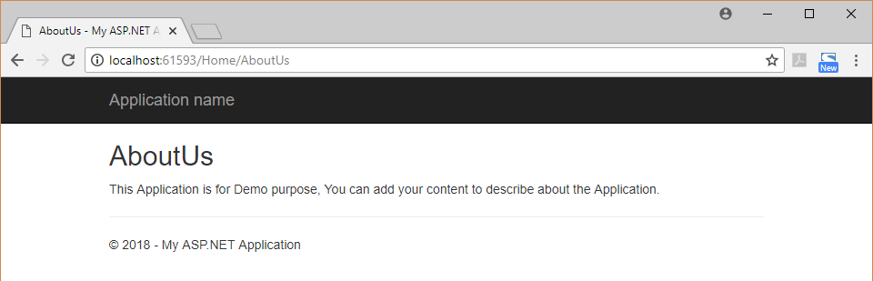
Views in ASP.NET (2-2)
For Aptech Centre Use Only
AboutUs
Output of Code Snippet 8
Erroneous AboutUs
Output of Code Snippet 7

Slide 18
Summary
MVC is a framework that helps developers to create Web applications in which sections of code are organized by the functions they perform.
Three basic components of MVC are Model, View, and Controller.
Fundamental pattern component of an MVC application is the component called the view. It is accountable for rendering the user interface, irrespective of it being an HTML or a UI widget on a desktop application.
A model can be defined as a collection of classes that help developers to work with data and business logic.
Validation forms a vital aspect in ASP.NET MVC applications. It helps developers to assess if the user input is valid.
Controllers form the central unit of the ASP.NET MVC application. It is the first unit that any incoming HTTP Request communicates with. It also has the responsibility of deciding which model to choose.
The MVC design pattern is definitely a great approach to create software applications. Projects created using MVC model consume lesser expenditure and time too.
For Aptech Centre Use Only

